Slide 1
NBA Stats and Fantasy Basketball
By: Jason Fine

Slide 2
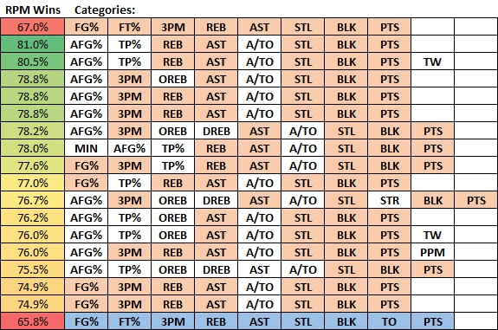
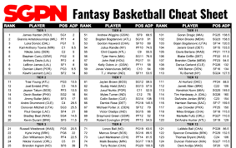
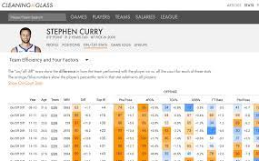
Fantasy Basketball – What is it?

Slide 3
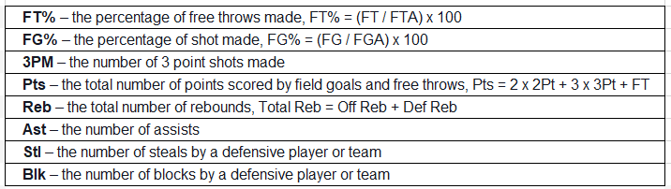
What data is being looked at?
NBA 2020-2021 Season Stats
Categories

Slide 4

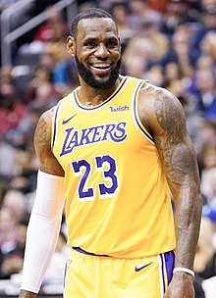
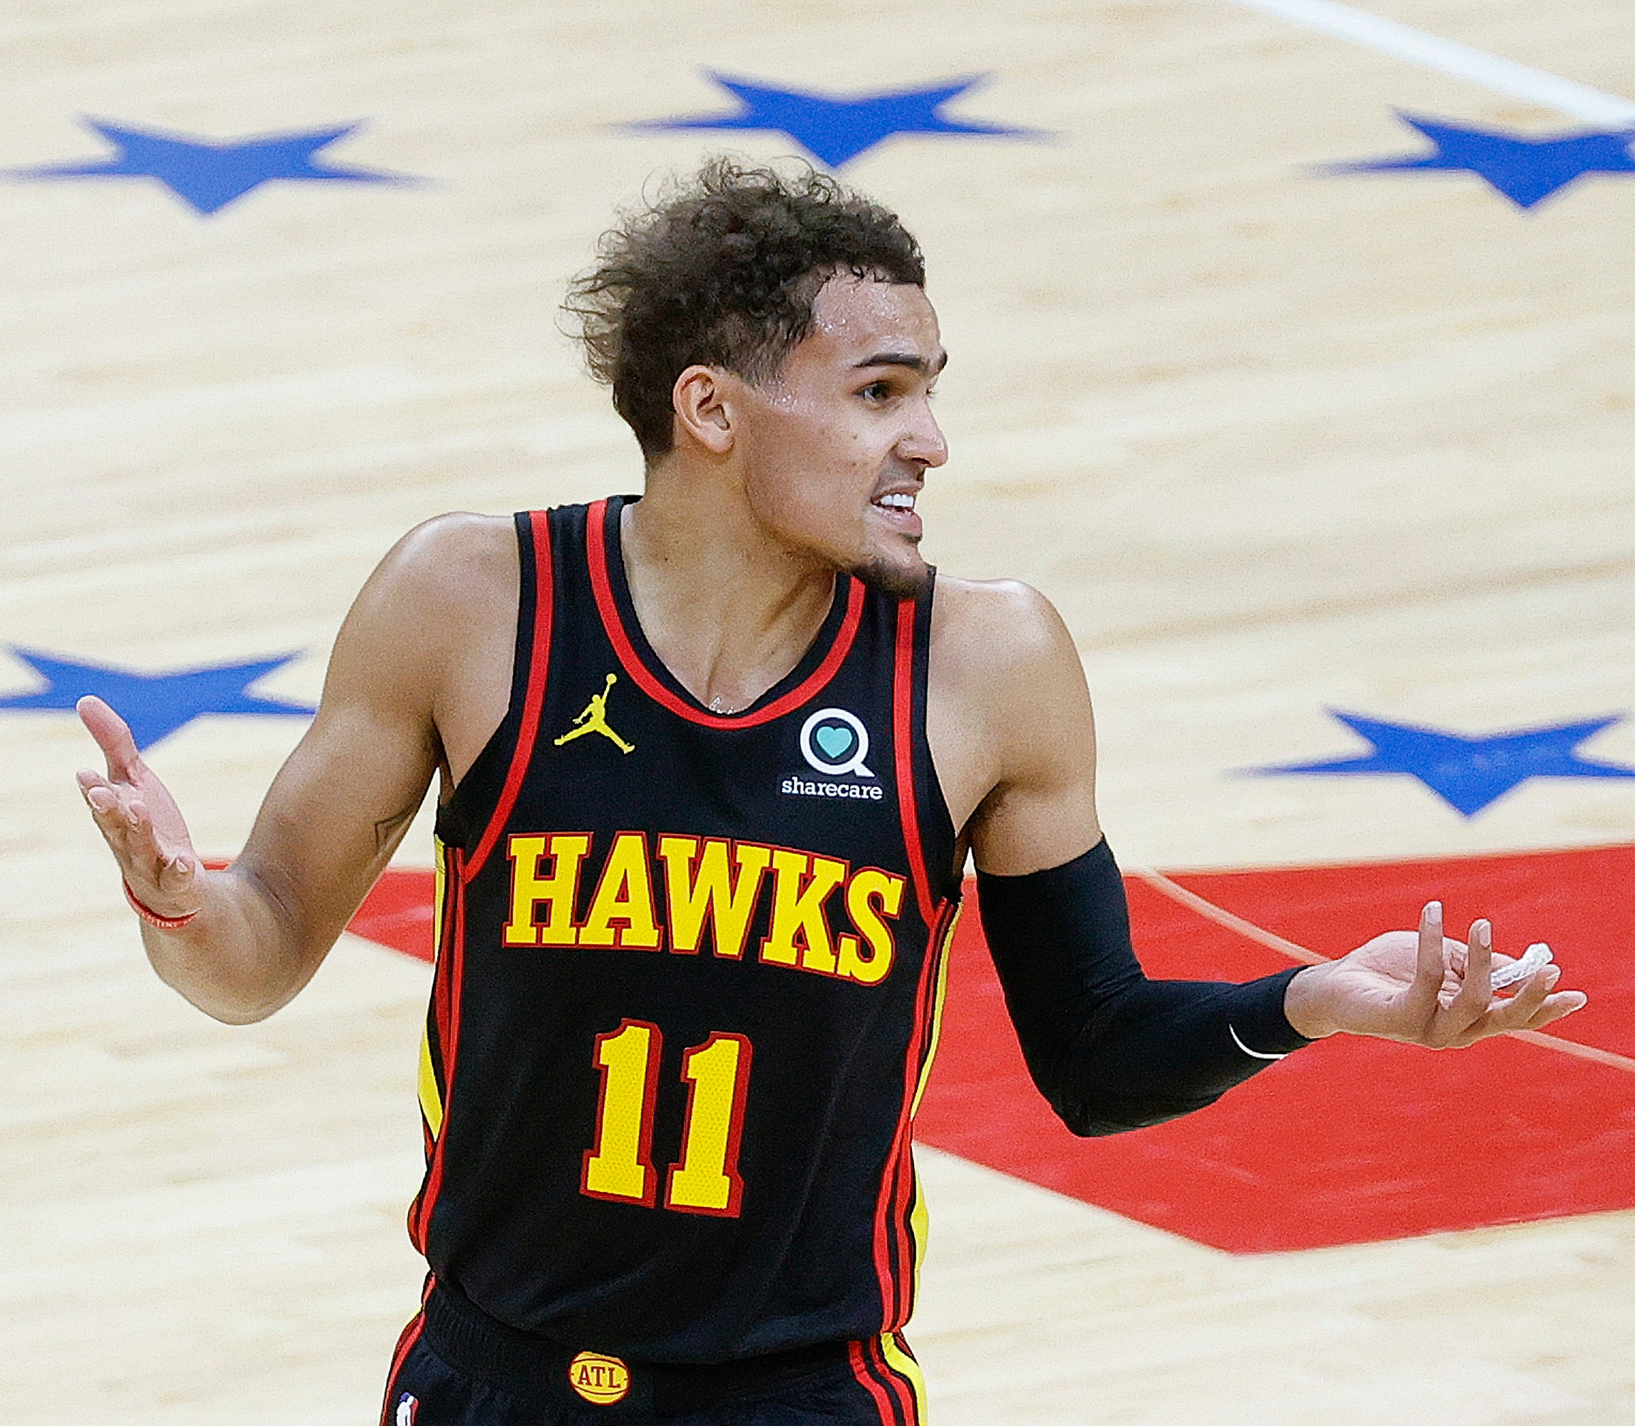
Process
Common strategy is to maximize all categories
Well-rounded teams are best
Clustering
Compare All-Stars who are likely drafted already
Give a substitute player

Slide 5
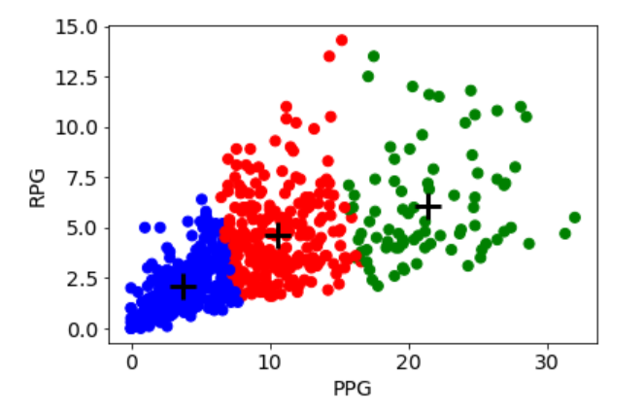
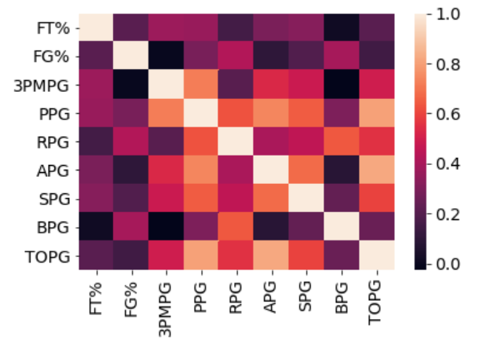
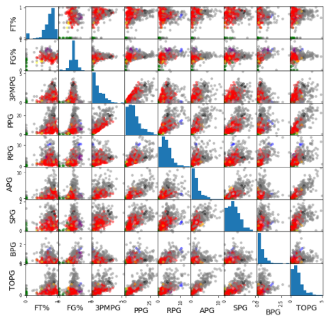
Initial Findings

Slide 6
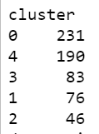
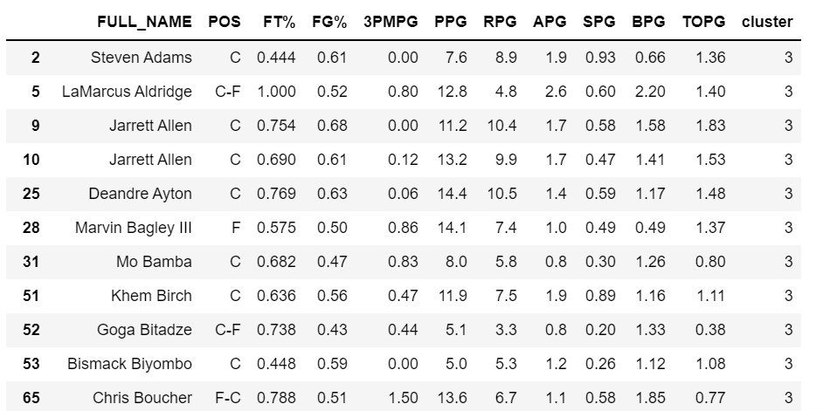
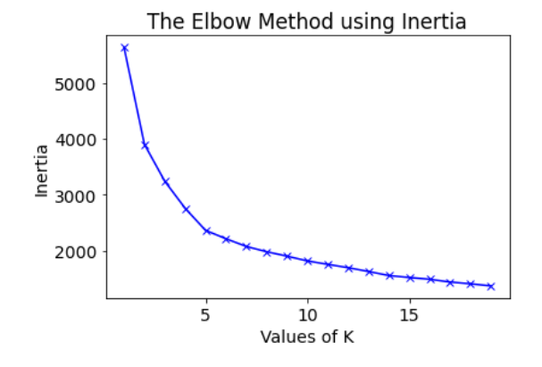
Initial Findings

Slide 7
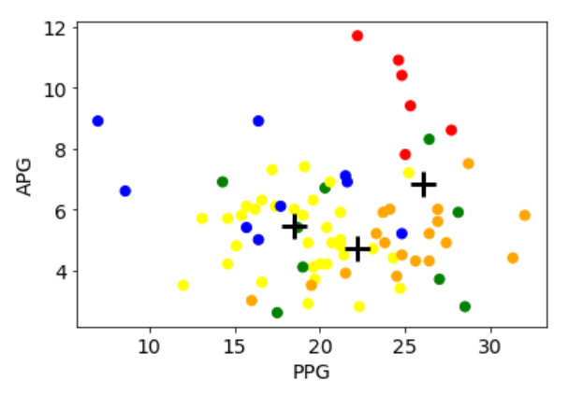
Findings
Looked at the most prominent stats for some clusters
Looked at the Assist Leaders cluster (red) and how they compared to others
Note the jumble of other clusters
These are categories that the other clusters ae not exceptional at

Slide 8
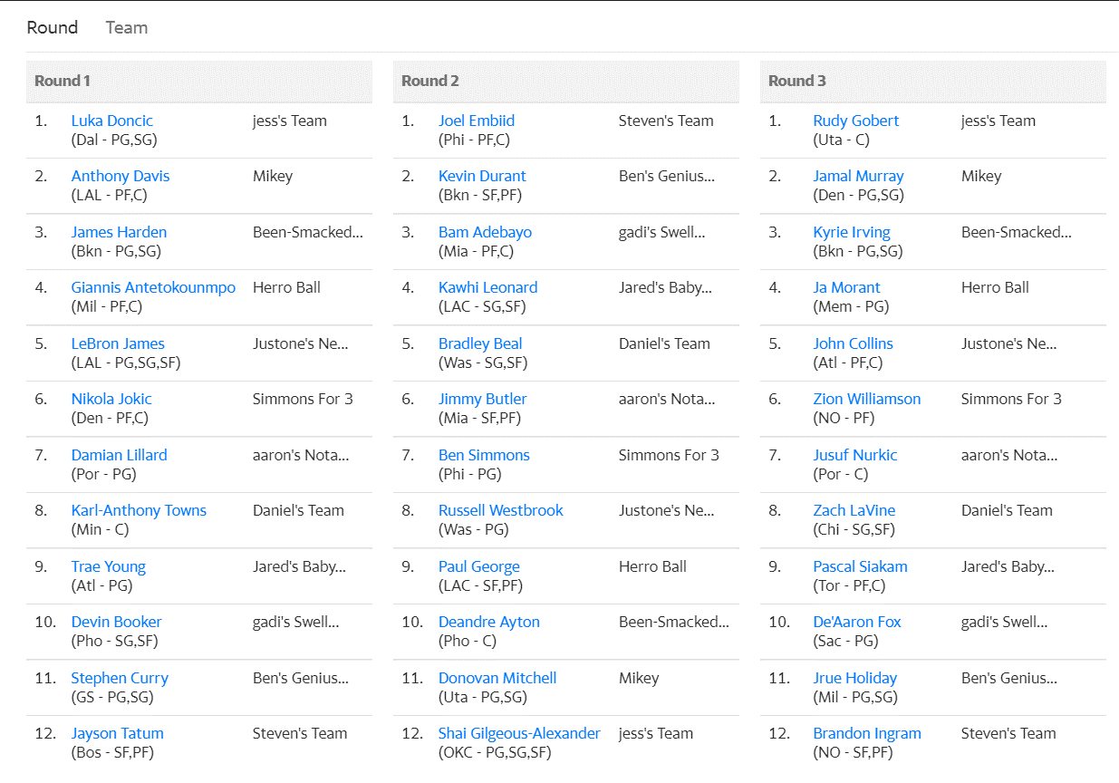
Final Product
Created a chart for finding best categories
Player list for top 100 players
At least one all-star per category
My Top 3 Draft Picks Were All From The Versatile Big Men Category

Slide 9
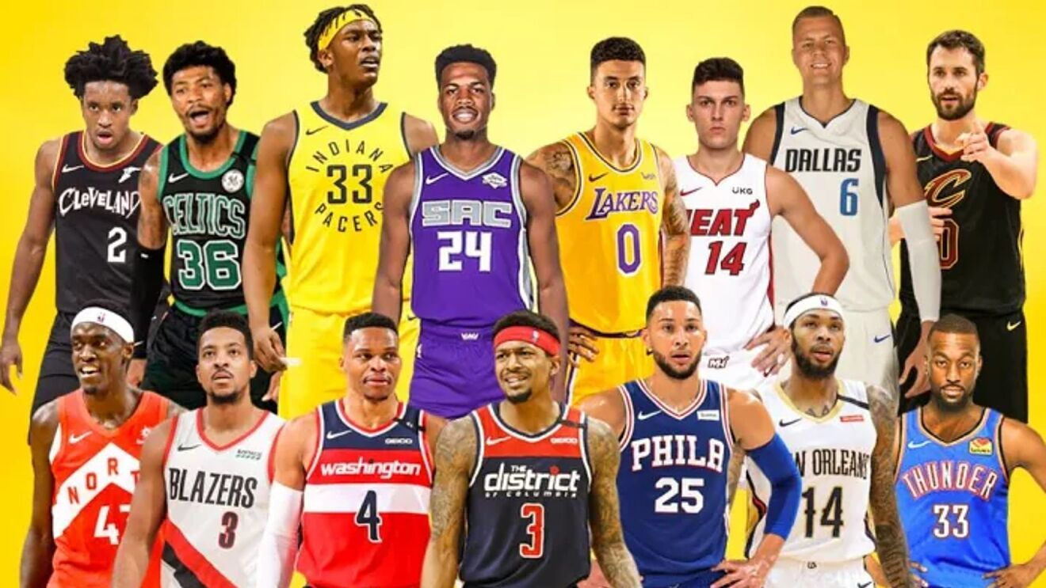
Any Questions?

